Slide 1
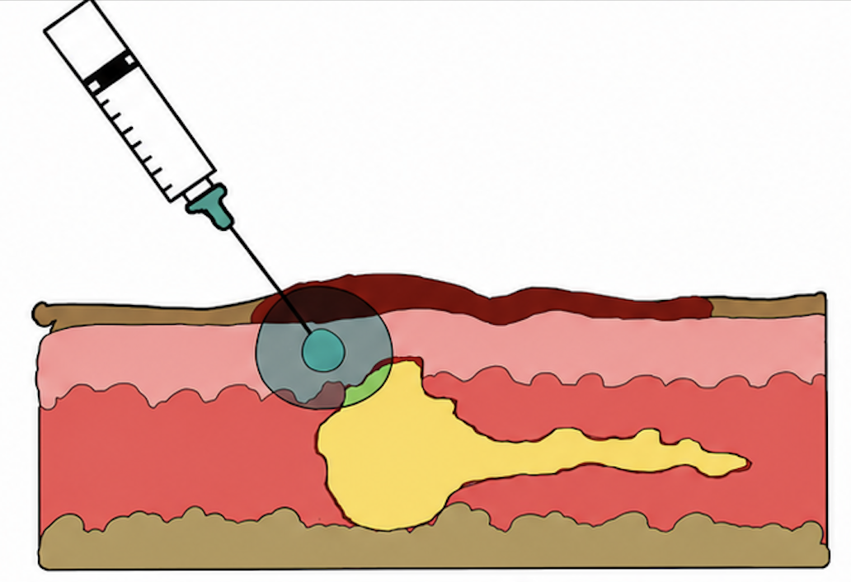


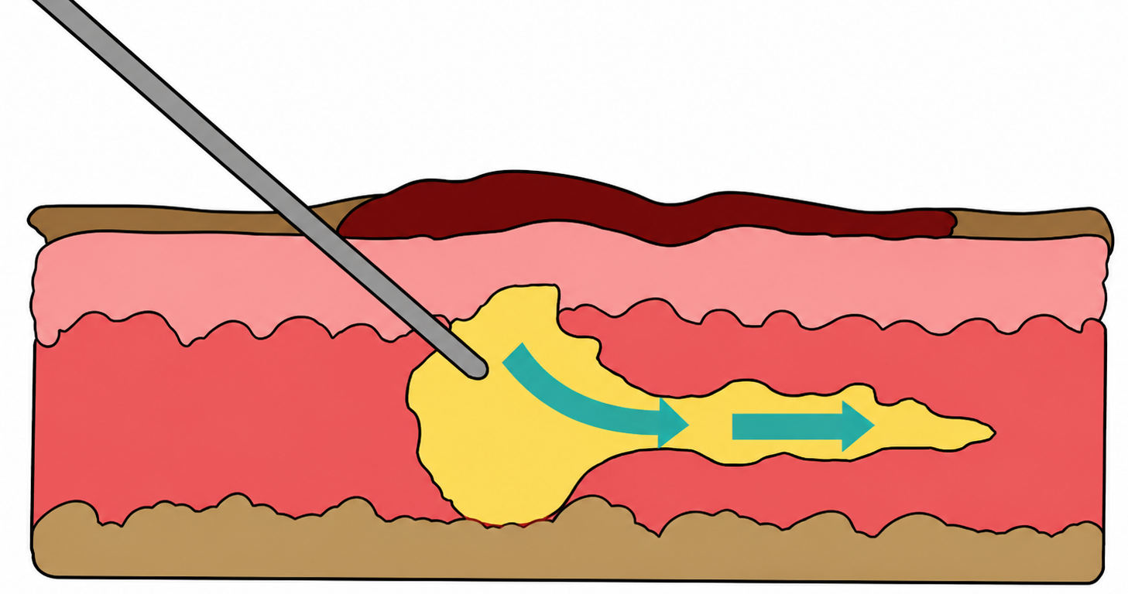
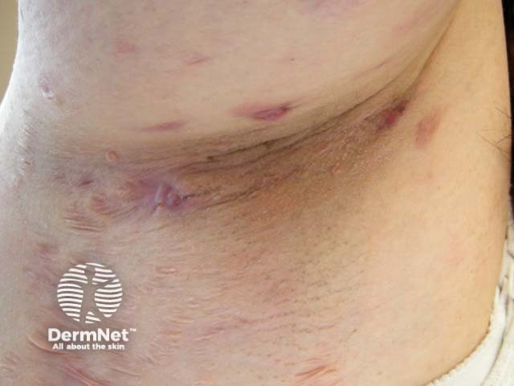
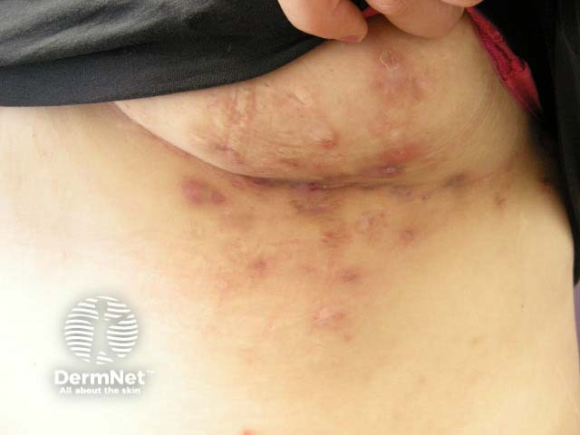
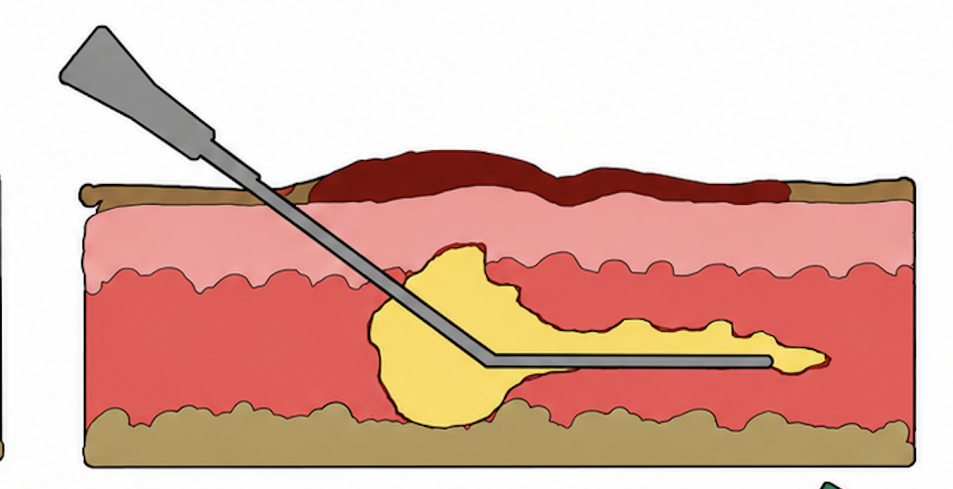
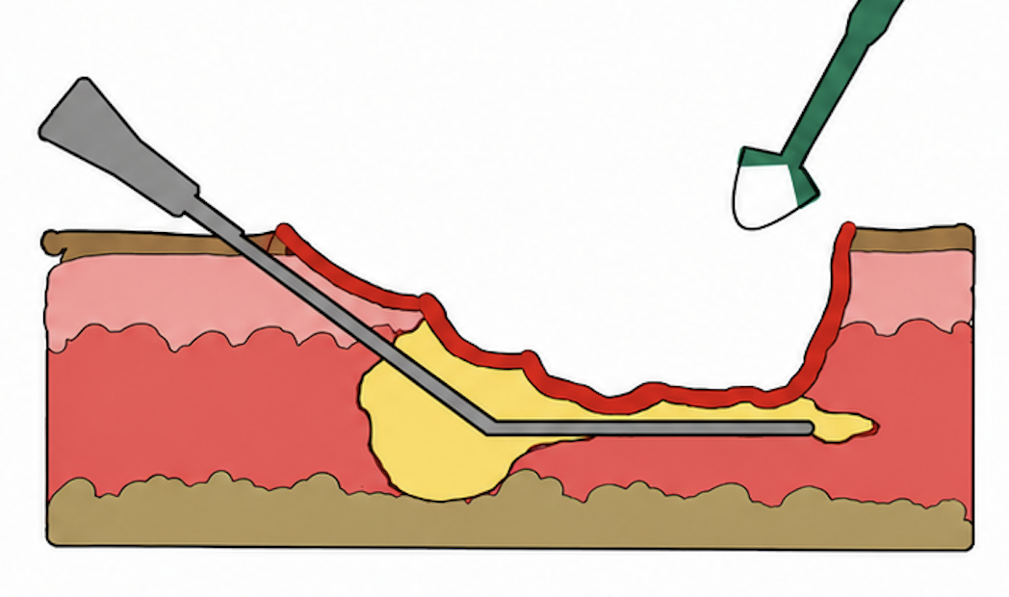
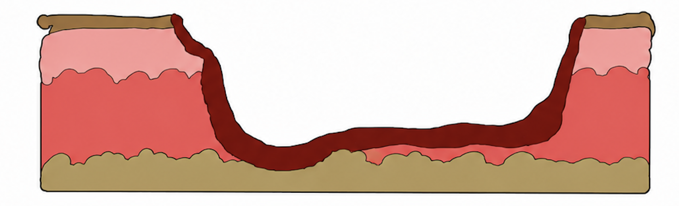
Deroofing Demystified: Understanding the surgical management of hidradenitis suppurativa through current educational resources Hebah Masood
What is HS and why is surgery needed?​
Hidradenitis suppurativa (HS) is a chronic inflammatory skin condition, characterised by the painful recurrence of deep-seated abscesses, nodules, sinus tunnels and the development of fibrotic scar tissue in intertriginous regions (Figures 1&2).¹
Etiology is not entirely understood, yet there is a pathophysiological link with follicular occlusion of the pilosebaceous units.²
Treatment for HS is currently non-curative, thereby concentrating on alleviating symptoms, minimising infection and reducing the recurrence of lesions.²
Contemporary management adopts a multimodal approach, combining pharmacological therapy and surgical intervention to optimise patient outcomes.
Typical surgical management involves incision and drainage of individual lesions or wide excision of diseased areas.
Despite limited execution in UK clinical practice, deroofing is alternative surgical procedure that is gaining increasing recognition.
Scan for some clinician resources from the HS Foundation
Local anaesthetic
1
Scan for a deroofing video aimed at Health Care Professionals
What are the advantages and limitations of deroofing?
Advantages | Limitations
Minimally invasive and tissue-sparing technique | Necessitates regimented post-procedural wound care until the wound has completely closed
Healing time is generally shorter, with larger diseased areas taking up to a few months to heal | Recurrence is still possible, despite rates being considerably lower when compared to alternative surgical procedures for HS
The procedure is short, simple, less costly and can be performed under local anaesthesia | Potential post-procedural complications such as infection, bleeding and pain
Scarring post-deroofing surgery is considered cosmetically acceptable | May not be suitable for areas classified as severe with extensive sinus networks
2
Probe
Probe
3
What current educational resources on deroofing exist?​
Resource type | Examples | Educational value
Implementation studies | Ingram et al. (2024) ⁵ | Explicitly aims to upskill healthcare services to perform deroofing as a surgical innovation rollout and assesses feasibility
Expert-led webinars | The Hidradenitis Suppurativa Foundation 'Cutting-Edge Management of HS In Primary Care' webinar ⁶ | Practical guidance and experience-led recommendations on deroofing, with opportunity for Q&A
Practical guide literature | Dzuali et al. (2024, vol. 13), Allison et al. (2022) ^{3,4} | Comprehensive instruction on preparation, equipment, techniques, wound care and implications
Evidence literature | Vu et al. (2025) ⁷ | Evidence-based guidance on technique and efficacy
Training videos | (Theseus, 2019)- THESEUS training video for healthcare professionals ⁸ | Visual step-by-step demonstration on deroofing surgery supporting technical understanding
Diathermy tool
4
Figure 1: Hidradenitis suppurativa of axilla. Image sourced from https://dermnetnz.org/ in accordance with CC BY-NC-ND license.
Figure 2: Hidradenitis suppurativa of breast. Image sourced from https://dermnetnz.org/ in accordance with CC BY-NC-ND license.
What is Deroofing?
Deroofing involves removal of the 'roof' of these sinus tunnels and extraction of any inflammatory debris before leaving the wound to heal by secondary intention.^{3,4}
Key surgical steps for health professionals working in dermatology (Figure 3):
Administer local anaesthetic surrounding the affected region and the specific lesions.
Insertion of a probe either into the sinus opening, if present, or through a small incision made proximal to the lesion.
This probe is then used to explore the sinus tunnel underneath the skin, gently probing in all directions to map out the entire network of the cavity.
Following the inserted probe as a guide, the roof of the sinus tunnel is excised using either a scalpel and surgical scissors or a diathermy tool. The floor of the lesion is now exposed.
Debridement is then performed, removing all inflammatory debris as well as the lining of the sinus tunnel. The area is probed once more for any remaining sinus tunnels before the open wound is left to heal by secondary intention.
What are the gaps in current educational resources on deroofing?​​​​​
​Existing resources vary in content, format and depth of material, with no standardised curriculum or formal framework to assess competency.
While videos and written guides can demonstrate technique, there is a lack of practical and simulation-based training opportunities for deroofing to support skill development and procedural confidence.
Access to current educational resources is largely dependent on individual initiative as deroofing is not part of a national training scheme, resulting in inconsistent exposure.
​
5
Why does this matter?
Deroofing is a minimally invasive, technically accessible procedure with few steps, making educating on a wider scale more feasible.
Bridging gaps in understanding of deroofing and its application in HS management supports trainees in providing appropriate effective treatment earlier on in disease progression, improving patient outcomes.
Broader awareness and implementation of deroofing will minimise variation in access to effective HS management across regions and care settings, improving equity of care.
Figure 3: Simplified illustration of deroofing technique
References
Napolitano, M., Megna, M., Timoshchuk, E., Patruno, C., Balato, N., Fabbrocini, G., & Monfrecola, G. (2017). Hidradenitis suppurativa: from pathogenesis to diagnosis and treatment. Clinical, Cosmetic and Investigational Dermatology, Volume 10(10), 105–115. https://doi.org/10.2147/ccid.s111019
Ballard, K., & Shuman, V. L. (2024). Hidradenitis suppurativa. In Nih.gov. StatPearls Publishing. https://www.ncbi.nlm.nih.gov/books/NBK534867/
Fiatsogbe Dzuali, Yaghi, M., & Saylor, D. K. (2024). Deroofing: a practical guide for the dermatologist. Current Dermatology Reports, 13(1), 1–7. https://doi.org/10.1007/s13671-024-00419-x
Allison, D., Sterner , J., Parker, J., & Martin , K. (2022). Surgical Deroofing for Hidradenitis Suppurativa | MDedge. Mdedge.Com. https://www.mdedge.com/dermatology/article/257714/autoimmune-diseases/surgical-deroofing-hidradenitis-suppurativa
Ingram, J. R., Bates, J., Cannings‐John, R., Collier, F., Evans, J., Gibbons, A., Harris, C., Howells, L., Hood, K., Howes, R., Leighton, P., Riaz, M., Rodrigues, J., Stanton, H., Kim, T., & Thomas‐Jones, E. (2023). treatment of hidradenitis suppurativa evaluation study (theseus): a prospective cohort study. British Journal of Dermatology, 3. https://doi.org/10.1093/bjd/ljad388
Cutting-edge Management of Hidradenitis Suppurativa (HS) in Primary Care | Clinical Directors Network, Inc. (2023, June 8). Clinical Directors Network, Inc. https://www.cdnetwork.org/library/cutting-edge-management-of-hidradenitis-suppurativa-hs-in-primary-care/
Vu, T. T., Soong, L. C., Hagtvedt, R., & Keeling, C. P. (2025). Surgical deroofing in the management of hidradenitis suppurativa alone or as an adjunct to medical therapies. Dermatologic Surgery, 51(7), e17–e21. https://doi.org/10.1097/dss.0000000000004604
Centre For Trials Research. (2019, October 13). Deroofing of sinus tracts in Hidradenitis Suppurativa for Healthcare Professionals. https://www.youtube.com/watch?v=ftizgrBMzok&t=2s
AI was only used to assist with the structure and layout of the poster as well as the cleanup of hand-drawn images.
As an accessible and effective procedure, deroofing warrants wider training and adoption within services to improve HS patient outcomes nationally.

