Slide 1
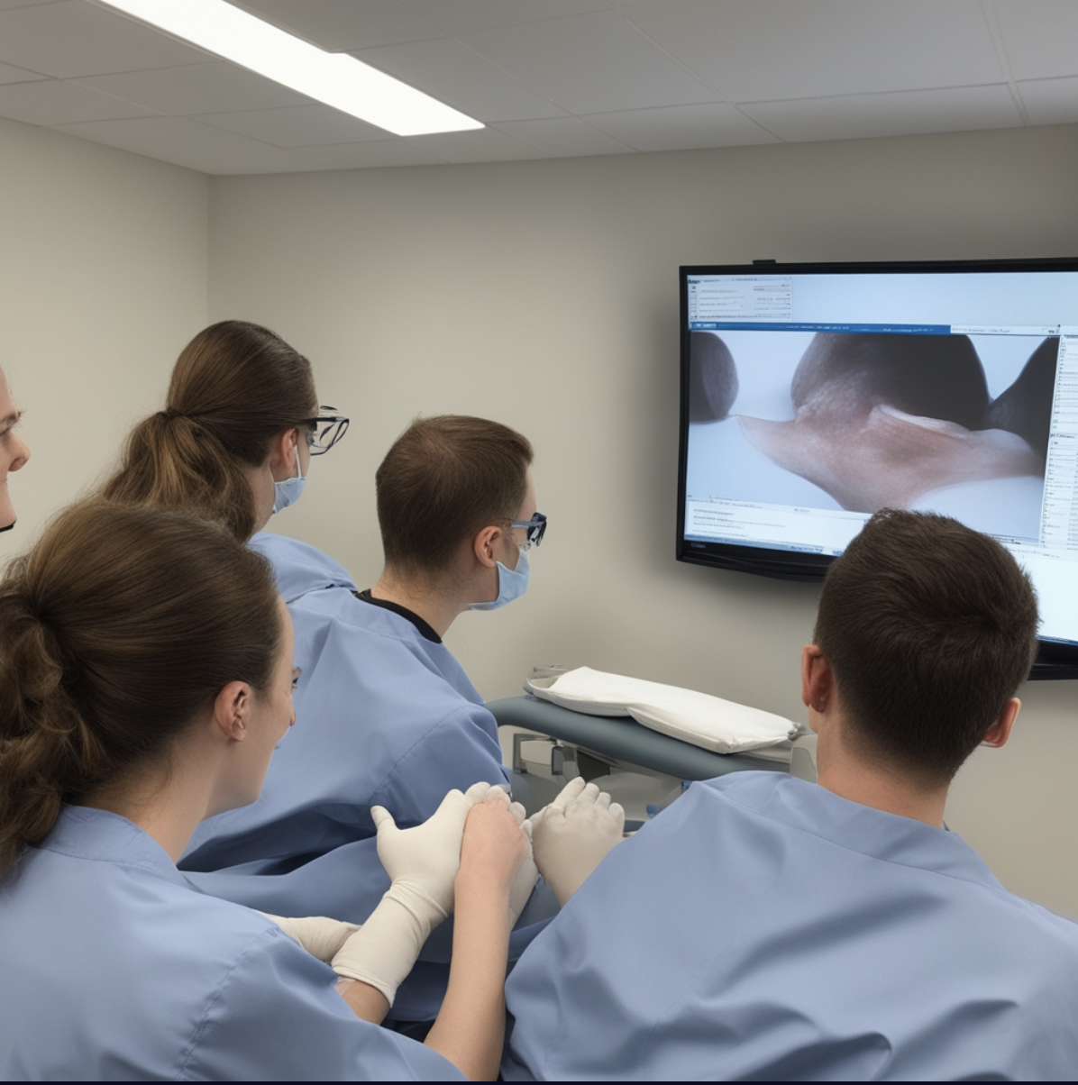
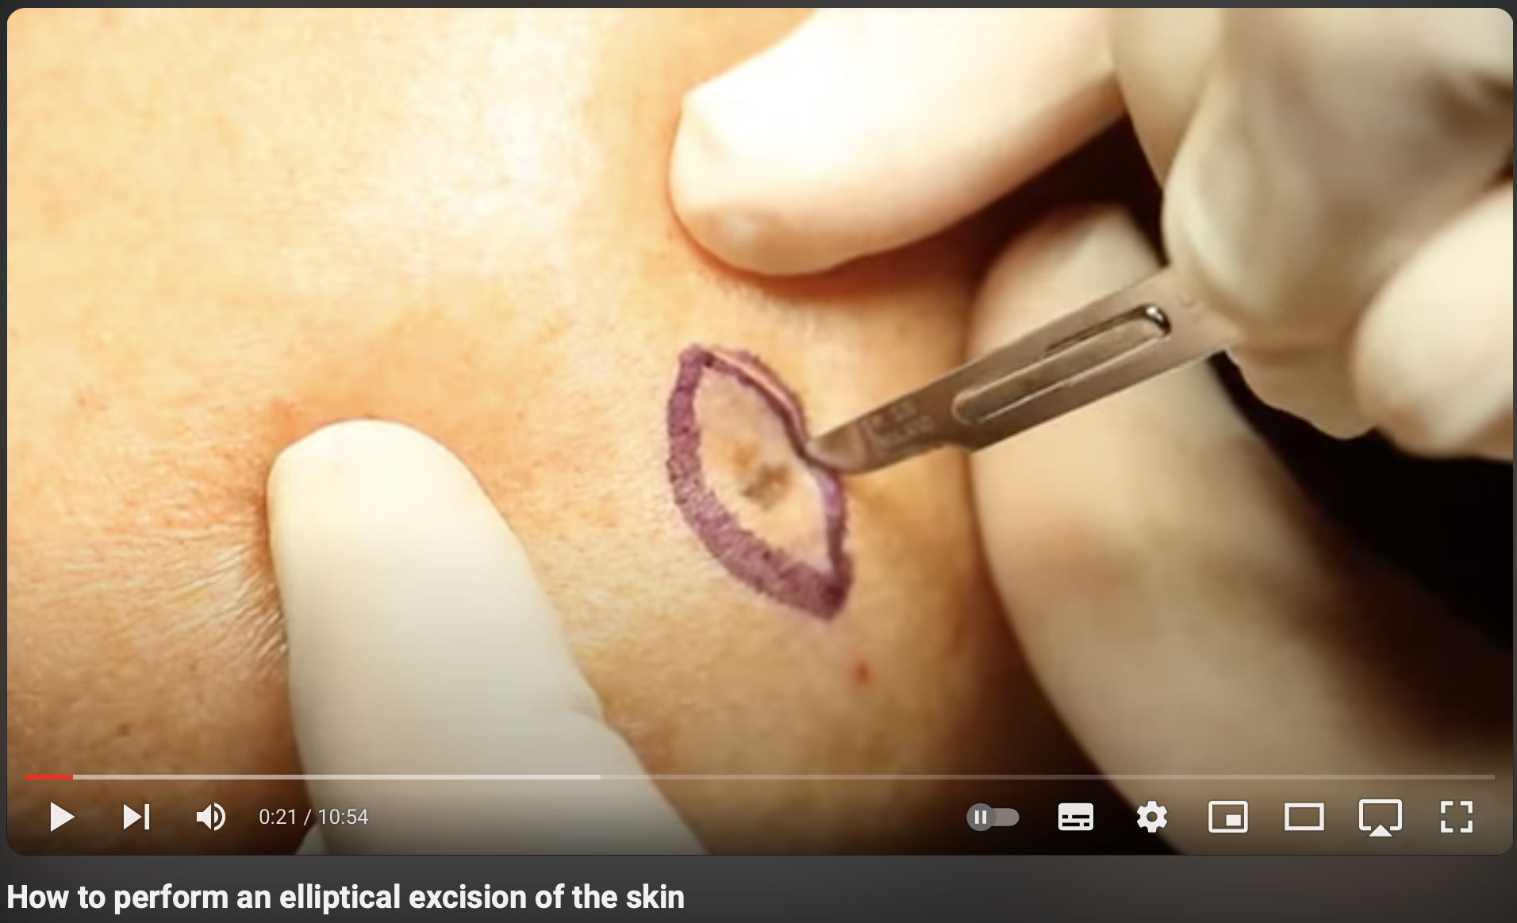
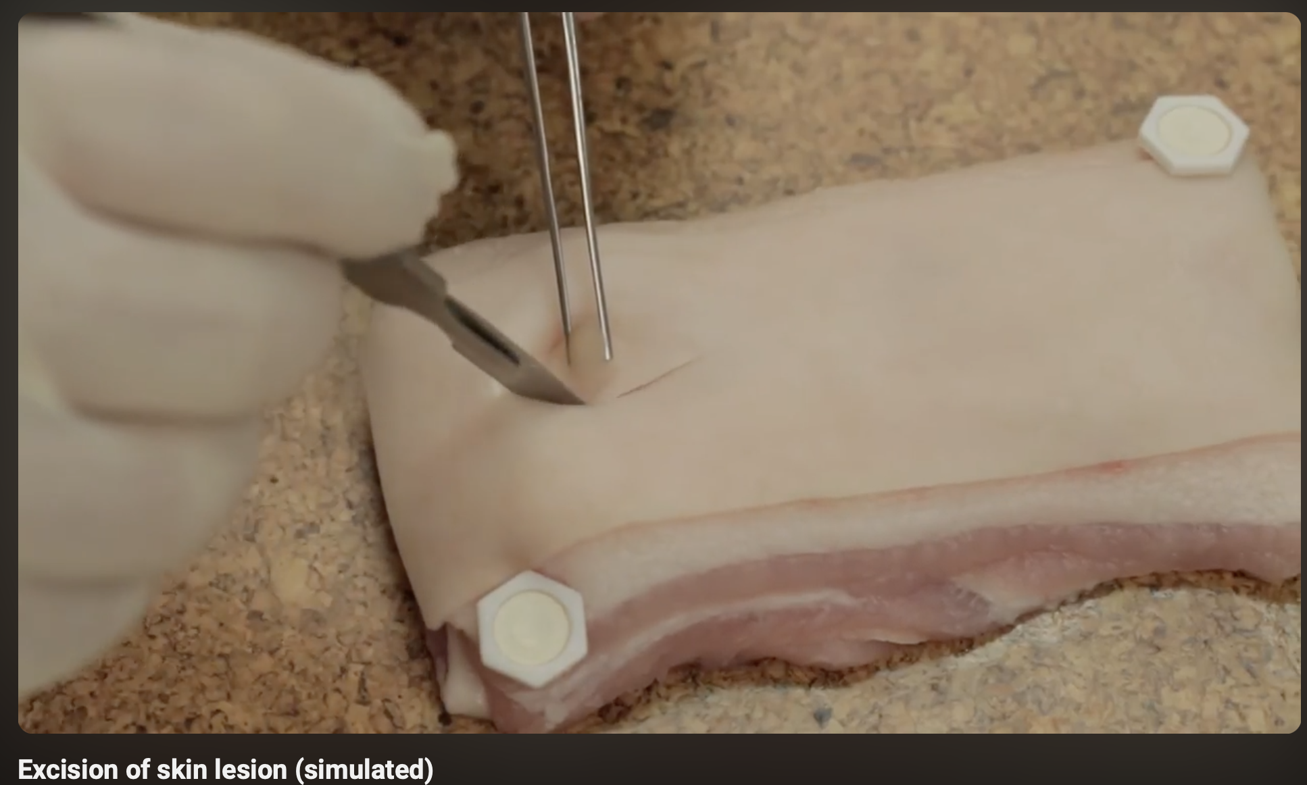
LAYING THE GROUNDWORK
Interactive E-learning:
Build the foundations via comprehensive e-learning videos and questions covering anatomy, procedure steps, and patient safety.
Verbal Teaching:
1-hour interactive commentary by surgical clinician throughout the videos to answer any of the student’s questions and expand on key steps.
Pre-test:
Student tested on relevant anatomy, ellipse excision steps and patient safety.
Pass is required in order to move onto next stage.
Instructional videos demonstrating a successful elliptical excision procedure and how to use surgical instruments.

Slide 2
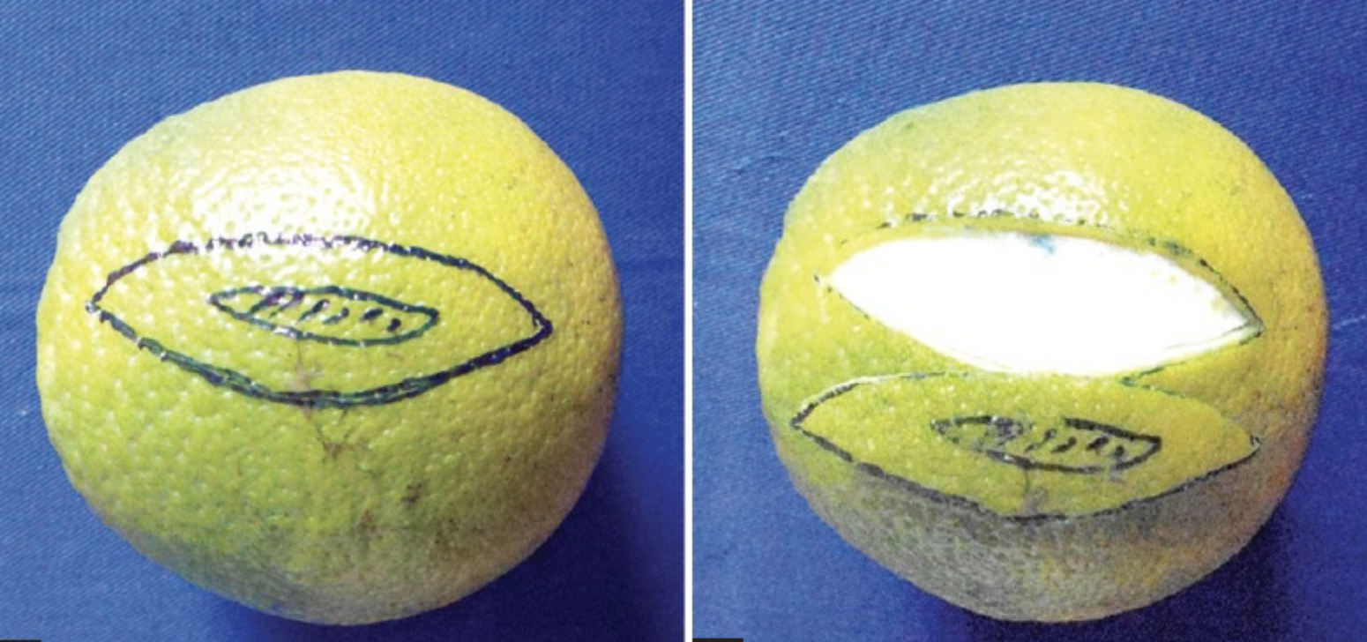
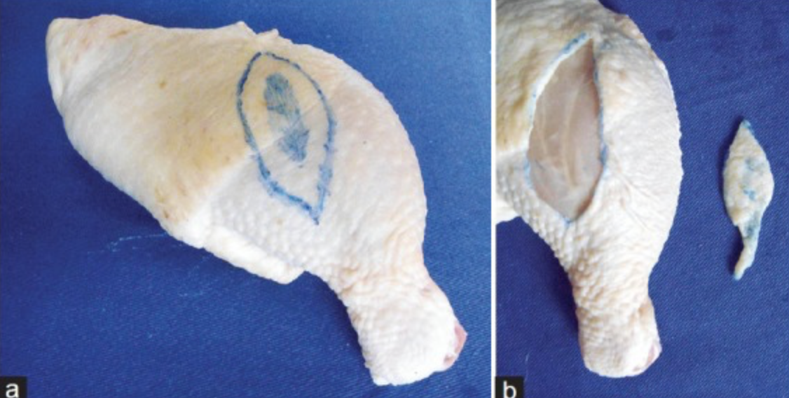
Hands-on mastery
Improve engagement:
Using haptic feedback mechanisms to stimulate tactile sensations of cutting and suturing to help with learning the skills!
Immersive VR simulation:
Next: Student practices in an immersive VR environment, allowing for repeated practice and real-time feedback without risk.
Once VR practice has been completed the procedure should be practiced on a low fidelity model.
Improve engagement:
Increased practice for the student through provision of low-fidelity models which can be practiced on multiple times before moving to high fidelity.
High-fidelity skin synthetic models:
Train on synthetic skin models which replicate the texture, multiple layers, and resistance of human skin.
Once completed successfully as observed by clinician, the student may progress.
Have VR interface show procedure steps and feedback metrics.
VR interface showing human subject before moving on to training on synthetic models.
Chicken leg
Skin suture trainer

Slide 3
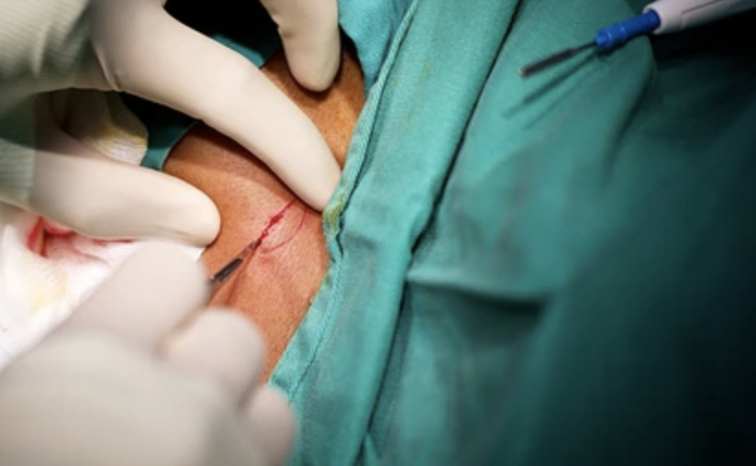
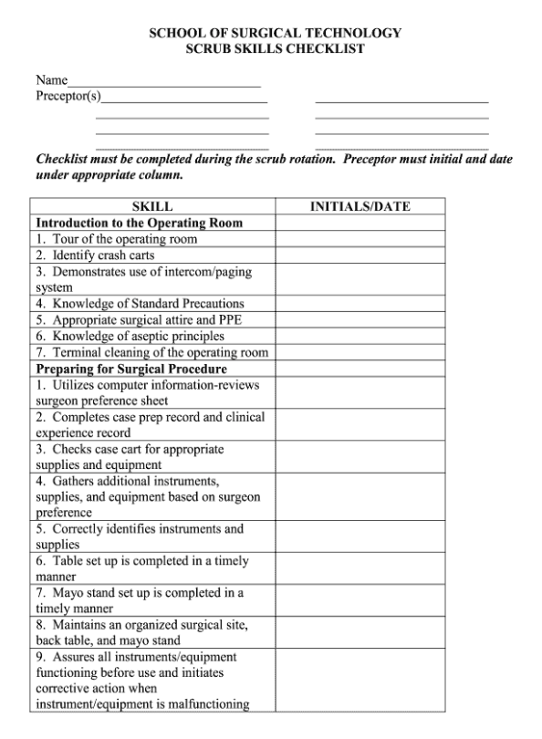
Bridging to clinical excellence
Whilst not a pre-condition to being signed off, group collaboration sessions encourage sharing tips resulting a more efficient acquisition of skills.
Mentored clinical sessions:
Student undertakes the procedure with the guidance of an experienced surgeon in a controlled clinical setting, ensuring patient safety.
Attaining excellence;
Students need to receive structured, detailed and tailored feedback to refine their technique and garner confidence
Peer to peer collaboration:
If training multiple students →
Engage in peer collaboration sessions where students can debrief and learn from each other’s experiences (successes and pitfall) to foster a collaborative learning environment.
Ultimate sign off:
Upon independent completion of a successful ellipse excision (under supervision), clinician may sign them off as competent.

